Slide 1
Post-Quantum Cryptography

Slide 2
Learning Outcomes
By the end of this lesson, students will be able to:
Define PQC and contrast it with quantum cryptography.
Understand core PQC approaches and resistance.
Identify real-world cybersecurity use cases (TLS, finance, defense).
Analyze cryptographic threats (Shor’s, Grover’s, brute-force).
Evaluate NIST standards and adoption roadmap.

Slide 3
What is Post-Quantum Cryptography (PQC)?
Definition
Why it matters?
Cryptographic algorithms designed to be secure against attacks from both classical computers and quantum computers
Problem
Quantum computers can break current encryption (e.g., RSA, ECC) using algorithms like Shor’s.
“Harvest Now, Decrypt Later”
Attackers collecting encrypted data today
Will decrypt when quantum ready
Solution
PQC is the only scalable mitigation before fault-tolerant quantum arrives.

Slide 4
PQC vs Quantum Cryptography
Feature | PQC | Quantum Cryptography
Basis | Hard math problems (eg. lattices) | Quantum physics (eg. entanglement)
Runs On | Classical computers | Requires quantum hardware
Goal | Resist future quantum attacks | Leverage quantum physics to securely transmit data and detect interception in real time
Examples | Kyber, Dilithium, SPHINCS+ | QKD, BB84
Scalability | High - deployable now | Low - limited and costly
Notes:
QKD – Quantum Key Distribution

Slide 5
NIST PQC Standardization
To identify and standardize public-key cryptographic algorithms that are secure against quantum computer attacks and can replace RSA, ECC, and Diffie-Hellman in modern systems.
Algorithms Selected:
Lattice-based: Kyber, Dilithium, FALCON
Hash-based: SPHINCS+
Code-based: Classic McEliece
Phase | Description
2016 | NIST launched the PQC project and called for algorithm submissions
2017-2022 | Phase 1-3: Public review of ~80 algorithms over multiple rounds
July 2022 | Finalist algorithms announced: 4 selected for standardization
Aug 2023-2024 | Draft standards (FIPS) released for public comment
2024-2025 | Final publication of standardized PQC algorithms

Slide 6
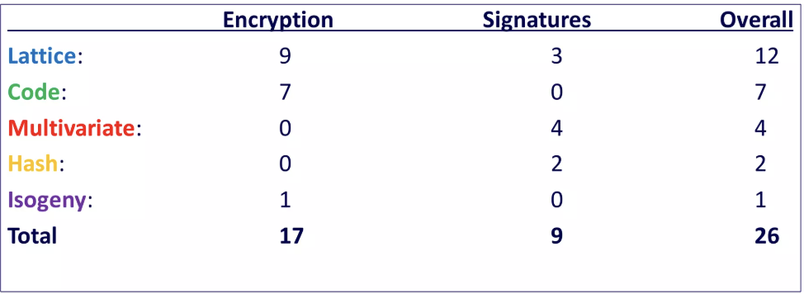
NIST Competition Currently

Slide 7
PQC Approaches

Slide 8
PQC Approaches Overview
1.
2.
3.
4.
5.
Lattice-Based
Cryptography
Hash-Based
Cryptography
Code-Based
Cryptography
Isogeny-Based
Cryptography
Multivariate
Cryptography

Slide 9
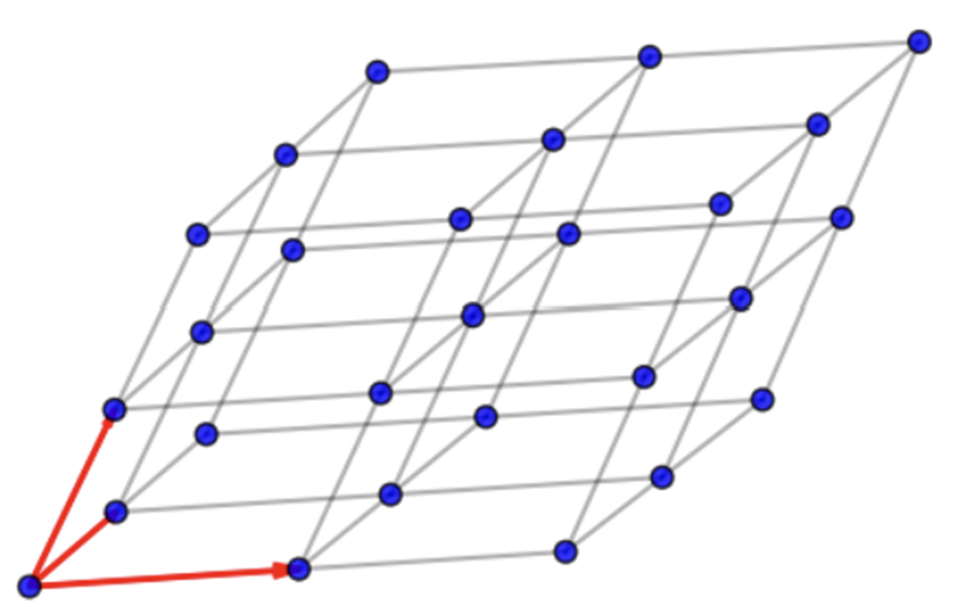
Lattice-Based Cryptography
Cryptography based on hard lattice problems
1996: NTRU (Hoffstein, Pipher, Silverman)
NIST: 9 Encryption, 3 Digital Signatures
Pros
Efficient, simple, adaptable
Very secure: some methods are as strong as the hardest lattice problems
Cons
Large key sizes
Notes:
Lattice-Based Cryptography
Lattice Problems: Lattice-based cryptography relies on mathematical problems involving lattices, which are grid-like structures made up of points in multi-dimensional space. These problems are considered "hard" because finding the shortest or closest vector in a lattice is computationally difficult, even for powerful computers. This hardness forms the foundation for secure cryptographic schemes.
NTRU: NTRU is one of the earliest and most well-known lattice-based cryptosystems, introduced in 1996 by Hoffstein, Pipher, and Silverman. It offers efficient encryption and decryption processes and has inspired many other lattice-based algorithms.
NIST Recognition: The National Institute of Standards and Technology (NIST) has recognized the importance of lattice-based cryptography by selecting 9 encryption algorithms and 3 digital signature schemes based on lattice problems for standardization. This highlights the growing trust in lattice-based methods for future-proof security, especially against quantum attacks.
Advantages:
Efficiency: Lattice-based schemes are generally fast and require less computational power, making them suitable for devices with limited resources.
Adaptability: They can be used for various cryptographic tasks beyond encryption and signatures, such as homomorphic encryption and identity-based encryption.
Strong Security Guarantees: Some lattice schemes are proven to be as secure as the hardest known lattice problems, providing confidence in their resistance to attacks.
Disadvantages:
Large Key Sizes: One of the main drawbacks is that lattice-based cryptosystems often require larger keys compared to traditional methods like RSA or ECC, which can impact storage and transmission efficiency.

Slide 10
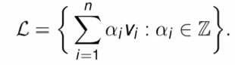
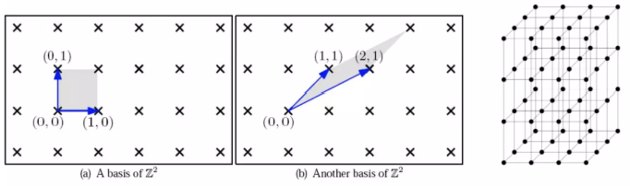
Lattice
Given n linearly independent vectors v1, . . . , vn Rn, the n-dimensional lattice they generate is
We then say the n x n matrix B = (v1, . . . , vn) is a basis for L := L(B).
Notes:
Lattices Lattices are regular, repeating arrangements of points in multidimensional space. Imagine a 3D grid extending infinitely in all directions, where each point can be precisely located using a combination of vectors. This geometric structure helps us visualize complex mathematical concepts in cryptography.
Mathematical Structure At the heart of lattices are basis vectors—these are the building blocks that generate every point in the lattice through integer combinations. The choice of basis affects the lattice's properties, and finding the shortest or closest vectors within a lattice is a challenging problem that underpins many cryptographic schemes.

Slide 11
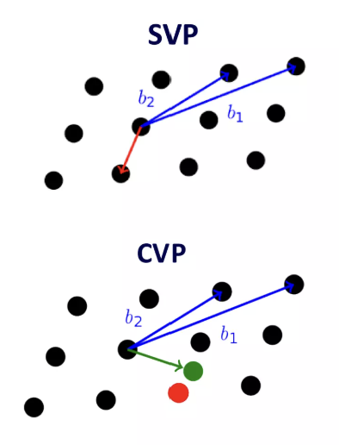
Hard Lattice Problems
Shortest Vector Problem (SVP): Given a basis for a lattice, find the shortest nonzero vector in the lattice
Given a ‘bad’ basis, this is NP-hard
Closest Vector Problem (CVP): Given a basis for a lattice and a target vector, find the closest lattice vector.
Generalization of SVP – same hardness
Special Case is Bounded Decoding Distance (BDD) Problem: Given a basis for a lattice and target vector of distance at most m to the lattice, find the closest lattice vector.
Notes:
Hard Lattice Problems
Shortest Vector Problem (SVP): Given a basis for a lattice, the goal is to find the shortest nonzero vector within that lattice. This problem is fundamental in computational lattice theory and has significant implications in cryptography and optimization. When the lattice basis is "bad" or poorly conditioned, solving SVP becomes computationally very difficult and is known to be NP-hard, meaning no efficient algorithm is known to solve all instances quickly.
Closest Vector Problem (CVP): Given a lattice basis and a target vector (which may not lie in the lattice), the task is to find the lattice vector closest to this target. CVP generalizes SVP because if the target vector is the zero vector, CVP reduces to SVP. Like SVP, CVP is also NP-hard, reflecting its computational complexity and importance in areas such as coding theory and cryptanalysis.
Bounded Distance Decoding (BDD) Problem: This is a special case of CVP where the target vector is guaranteed to be within a certain bounded distance (at most m) from the lattice. The problem is to find the closest lattice vector to this target. BDD is particularly relevant in decoding lattice-based codes and has applications in secure communication and cryptographic protocols.
These problems form the backbone of many cryptographic schemes, especially those based on lattice hardness assumptions, which are considered promising candidates for post-quantum cryptography due to their resistance to quantum attacks.

Slide 12
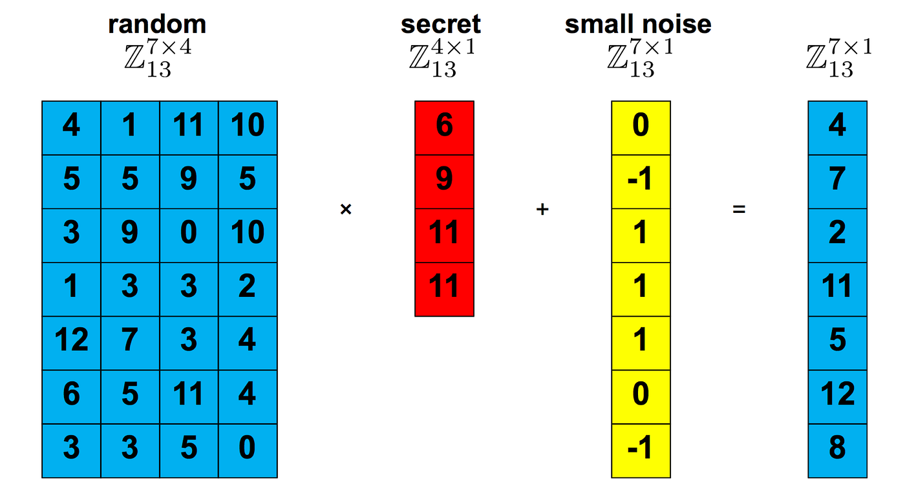
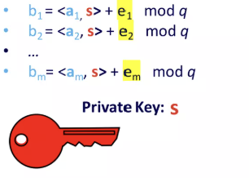
Learning With Errors (LWE)
Each a_{i} is a random vector
The s is the secret vector
Each e_{i} is the error term – a small random number
Problem: Given the pairs (a_{i},b_{i}) for i = 1, … , m, find the secret vector s
Formulated as a Bounded Distance Decoding lattice problem:
Given A = {(a_{i})} a matrix, b = {(b_{i})} = As + e mod q, where is from e error distribution,
Find target vector s close enough to lattice generated by solutions to y = As mod q
Notes:
Problem Statement
You have pairs of vectors and noisy results, and the goal is to find the secret vector that created them. This is an important problem in cryptography.
Example: Suppose you have vectors like (1, 2) and (3, 4), and noisy results like 5 and 11. The challenge is to find the secret vector that, when combined with these vectors, produces those results with some small errors.
Bounded Distance Decoding (BDD) Lattice Problem
Make a matrix from the given vectors.
The noisy results form a target vector, which equals the matrix times the secret vector plus some error.
Find the secret vector so that the matrix times it is as close as possible to the target vector.
"Close" means within the error limits, making this problem hard and secure for cryptography.

Slide 13
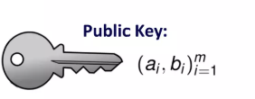
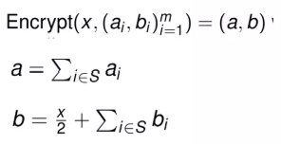
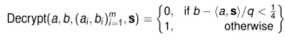
LWE Lattice Scheme (asymmetric encryption & decryption)
Alice
Bob
1. KEY GENERATION
Bob has bit x = 0 or 1
2. ENCRYPTION
Alice sends public key to Bob
Bob sends ciphertext (a,b) to Alice
3. DECRYPTION
Eve
Recover S by solving Bounded Distance Decoding Problem
Notes:
Alice and Bob
Alice and Bob are the two primary participants in this cryptographic communication. Bob wants to send a secure message to Alice using an encryption scheme based on the Learning With Errors (LWE) lattice problem.
Eve
Eve represents a potential eavesdropper or adversary who tries to intercept or decipher the communication between Alice and Bob without authorization.
LWE Lattice Scheme
The Learning With Errors (LWE) lattice scheme is a modern cryptographic approach that relies on the hardness of certain lattice problems. It provides strong security guarantees even against quantum computers, making it a promising candidate for post-quantum cryptography.
Asymmetric Encryption & Decryption
This scheme is asymmetric, meaning it uses a pair of keys: a public key for encryption and a private key for decryption. Alice generates these keys and shares the public key with Bob, who uses it to encrypt his message.
Alice Sends Public Key to Bob
Alice generates a public-private key pair and sends the public key to Bob. This key allows Bob to encrypt messages that only Alice can decrypt with her private key.
Public Key
The public key consists of vectors and parameters derived from the lattice structure and the secret vector ( s ). It is used by Bob to create ciphertexts that hide the message securely.
Recover ( s ) by Solving Bounded Distance Decoding Problem
The private key ( s ) is a secret vector that can be recovered only by solving the Bounded Distance Decoding (BDD) problem on the lattice, which is computationally hard. This hardness ensures the security of the scheme.
1. Key Generation
Alice selects a secret vector ( s ) and generates the corresponding public key components based on lattice parameters and noise terms.
2. Encryption
Bob encrypts a bit ( x ) (either 0 or 1) by computing ciphertext components:
( b_1 = \langle a_1, s \rangle + e_1 \mod q )
( b_2 = \langle a_2, s \rangle + e_2 \mod q )
( \ldots )
( b_m = \langle a_m, s \rangle + e_m \mod q ) Here, each ( a_i ) is a public vector, ( e_i ) is a small error term (noise), and ( q ) is a modulus. The noise terms ensure the hardness of decoding without the private key.
3. Decryption
Using her private key ( s ), Alice decrypts the ciphertext by solving the Bounded Distance Decoding problem to recover the original bit ( x ). The noise terms are small enough to allow correct recovery but large enough to prevent attackers from easily solving the problem.

Slide 14

Code-Based Cryptography
Cryptography based on error correcting codes: maps that ‘correct’ the error of a input i.e. f(x+e) = x for small error e
1978: McEliece
NIST: 7 Encryption
Pros
Fast to encrypt/decrypt
Hardness well studied and understood (>40 years)
Cons
Large key sizes (10,000-1 million bits)
Classic McEliece
NTS-KEM
BIKE
HQC
LEDAcrypt
Rollo
RQC

Slide 15
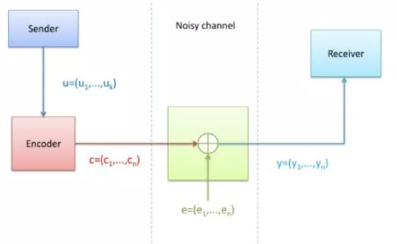
Code-Based Cryptography
Builds on the concepts introduced by Claude Shannon in 1948.
Coding theory was developed to be able to retrieve the original message after transmission through a noisy channel.
A concept that is easily adaptable to cryptography
Artificial noise can be applied to a message to hide its contents.
The original recipient can recover the message by knowing additional information about the encoding scheme.

Slide 16
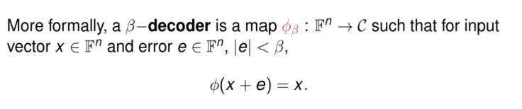
Error Correcting Codes
Triplet received | Interpreted as
000 | 0 (error free)
001 | 0
010 | 0
100 | 0
111 | 1 (error free)
110 | 1
101 | 1
011 | 1
A map is error correcting if it sends an input (+/- small error) back to itself, that is, it ‘corrects the error’
Notes:
Error Correcting Codes
Error Correcting Code Definition: An error correcting code is a specialized mapping or function designed to enhance the reliability of communication and data storage systems. It encodes an input message so that even if the message is affected by small errors during transmission or storage, the original information can still be accurately recovered.
Triplet Received and Interpretation: In many error correcting systems, data is transmitted and received in fixed-size groups called triplets, which consist of three bits or symbols. When a triplet is received, it may have been altered by noise or interference, causing one or more bits to flip. The system then interprets this received triplet by comparing it against the set of valid codewords defined by the error correcting code. Using this comparison, the system identifies the closest valid triplet (original codeword) to the received one and corrects any errors by mapping the received triplet back to this original.
Error Correction Mechanism: Specifically, a map is considered error correcting if it can take an input that has been slightly altered—such as a few bits flipped due to noise or interference—and correct it by mapping it back to the original input. This capability allows the system to detect and fix errors without requiring retransmission, which is vital for efficient and reliable data handling.

Slide 17
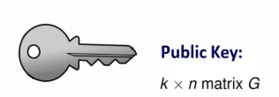
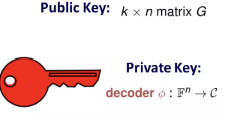
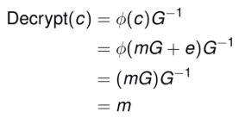

McEliece Code-based Scheme (asymmetric encryption & decryption)
Alice
Bob
1. KEY GENERATION
Bob has message m vector
2. ENCRYPTION
Given message m and small random error vector e, get ciphertext
Encrypt(m) = c = mG + e
Alice sends public key G to Bob
Bob sends ciphertext c to Alice
3. DECRYPTION
Eve
Find $φ$ without knowing error e
Notes:
Alice and Bob Communication
Alice and Bob are the two primary parties involved in the communication process. Alice wants to receive a secure message from Bob.
Eve - The Eavesdropper
Eve represents a potential attacker or eavesdropper who tries to intercept or decipher the communication between Alice and Bob without authorization.
McEliece Code-based Scheme
This is a type of asymmetric encryption method that relies on error-correcting codes, specifically designed to be resistant to quantum computer attacks.
It uses a public key for encryption and a private key for decryption, leveraging the difficulty of decoding a general linear code with errors.
Asymmetric Encryption & Decryption Process
Public Key (G): Alice generates and sends a public key matrix (G) to Bob. This key is used by Bob to encrypt his message.
Private Key: Alice keeps a private key that includes the knowledge of the error vector (e) and the structure of the code, which allows her to efficiently decrypt the ciphertext.
1. Key Generation
Alice generates a pair of keys: a public key (G) and a private key that includes the secret error vector and decoding algorithm.
2. Encryption
Bob takes his message represented as a vector (m).
He adds a small, random error vector (e) to the encoded message using the public key (G), producing the ciphertext (c).
This error vector is crucial for security, as it makes decoding without the private key computationally infeasible.
3. Decryption
Alice receives the ciphertext (c) from Bob.
Using her private key, she applies an efficient decoding algorithm to correct the errors introduced by (e) and recover the original message (m).
This process ensures secure communication by making it extremely difficult for Eve to decode the message without the private key, even if she intercepts the ciphertext.

Slide 18
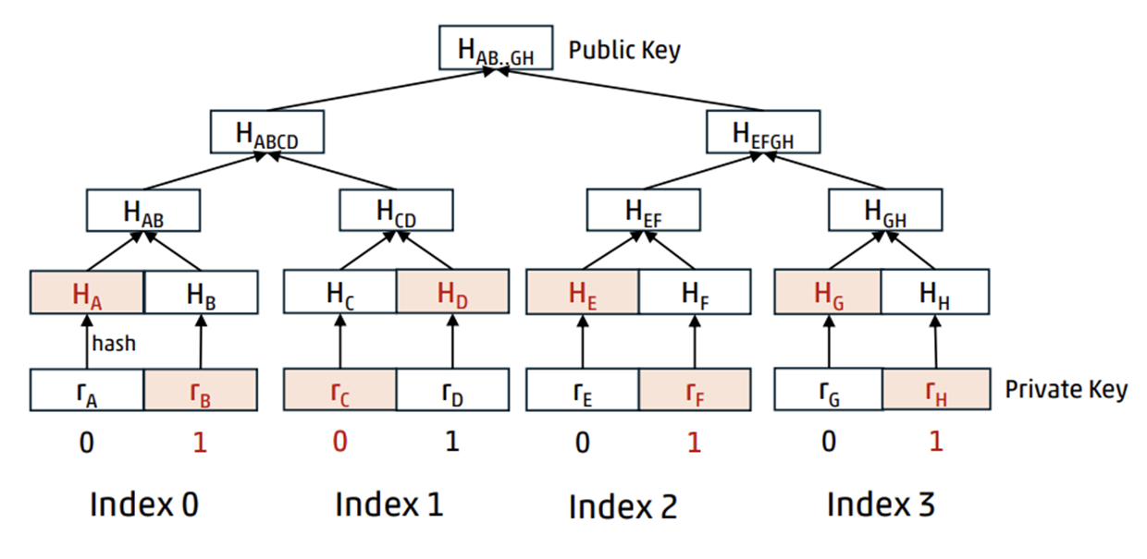
Hash-Based Cryptography
Cryptography based on hash functions
1978: Combine one-time hash signatures with Merkle tress
NIST: 2 Digital Signatures
SPHINCS+
Picnic
Pros
Only security assumption is security of hash function
Easily replace hash functions with newer/efficient/secure
Fast
Cons
Large private key and signatures
Only finite number of signatures
Notes:
Hash-Based Cryptography
• Cryptography based on hash functions Hash-based cryptography relies fundamentally on the properties of cryptographic hash functions, which transform input data into fixed-size hash values. These functions are designed to be one-way and collision-resistant, making them ideal for secure digital signatures.
• 1978: Combine one-time hash signatures with Merkle trees (Merkle) In 1978, Ralph Merkle introduced a groundbreaking approach by combining one-time hash-based signatures with Merkle trees. This method allows many one-time signatures to be aggregated efficiently, enabling the creation of scalable and secure digital signature schemes.
• NIST: 2 Digital Signatures The National Institute of Standards and Technology (NIST) has recognized and standardized two hash-based digital signature schemes as part of its post-quantum cryptography efforts, highlighting their importance in future-proof security.
• Picnic Picnic is a digital signature scheme that combines hash-based cryptography with zero-knowledge proofs, offering strong security guarantees and resistance against quantum attacks.
• SPHINCS+ SPHINCS+ is a stateless hash-based signature scheme designed to provide high security without the need for state management, making it practical for various applications requiring post-quantum security.
• Pros
Only security assumption is security of hash function: The security of hash-based cryptography depends solely on the strength of the underlying hash functions, which are well-studied and widely trusted.
Easily replace hash functions with newer/efficient/secure: As cryptographic hash functions evolve, hash-based schemes can adapt by swapping in newer or more efficient hash functions without redesigning the entire system.
Fast: Hash computations are generally efficient, enabling quick signature generation and verification compared to some other cryptographic methods.
• Cons
Large private key and signatures: Hash-based schemes often require larger keys and signature sizes, which can impact storage and transmission efficiency.
Only finite number of signatures: Many hash-based signature schemes are limited to a fixed number of signatures per key pair, necessitating careful key management or the use of advanced constructions like Merkle trees to extend usability.

Slide 19
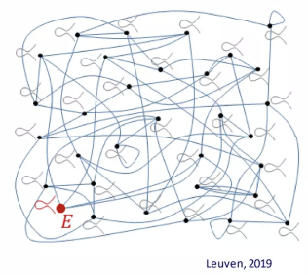
Isogeny-Based Cryptography
Cryptography based on maps between elliptic curves
2011: SIDH (Supersingular Isgoney Diffie-Hellman)
NIST: 1 Encryption
SIKE (Supersingular Isogeny Key Exchange)
Pros
Smallest key sizes of all remaining cryptosystems: 6000 bits
Cons
Security problem upon which SIKE not been studied as much
Slower than many other candidates
Notes:
Isogeny-Based Cryptography
Mathematical Transformations Between Elliptic Curves: This approach leverages isogenies, which are special types of functions mapping one elliptic curve to another while preserving their algebraic structure. These mappings form the foundation for constructing cryptographic protocols that are believed to be resistant to attacks by quantum computers, making them a promising candidate for post-quantum cryptography.
SIDH Protocol (Supersingular Isogeny Diffie-Hellman): Introduced in 2011 by De Feo, Jao, and Plût, SIDH is a key exchange mechanism that uses supersingular elliptic curve isogenies to enable two parties to securely establish a shared secret over an insecure channel. Its design exploits the difficulty of computing isogenies between supersingular elliptic curves, which is considered a hard mathematical problem.
NIST Recognition: The National Institute of Standards and Technology (NIST) has identified isogeny-based cryptography as a strong candidate for standardization in the realm of quantum-resistant encryption. This endorsement highlights the potential of these methods to secure communications in a future where quantum computing could break many classical cryptographic schemes.
SIKE Protocol (Supersingular Isogeny Key Encapsulation): Building on SIDH, SIKE is a key encapsulation mechanism designed to provide secure key exchange with compact key sizes. It encapsulates a secret key within a ciphertext, allowing secure transmission and decryption by the intended recipient. SIKE aims to balance security with efficiency, particularly in environments where bandwidth or storage is limited.
Advantages:
The standout benefit of isogeny-based cryptography is its remarkably small key sizes compared to other post-quantum candidates, typically around 6,000 bits. This compactness makes it attractive for applications with strict constraints on memory and transmission bandwidth.
Drawbacks:
Despite its promise, the security assumptions underlying SIKE have not undergone as extensive cryptanalysis as some other post-quantum algorithms, leaving some uncertainty about its long-term robustness.
Additionally, isogeny-based protocols generally exhibit slower computational performance relative to many alternative quantum-resistant cryptosystems, which can impact their practicality in time-sensitive applications.

Slide 20
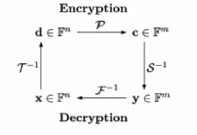
Multivariate Cryptography
Cryptography based on polynomial equations in multiple variables
1998: C* (Matsumoto Imai) now broken but inspired other schemes
1996: HFE Hidden Field Equations (Patarin)
NIST: 4 Digital Signatures
GeMSS
LUOV MQDSS
Rainbow
Pros
Fast (much faster than RSA)
Small signature size
Operations are simple arithmetic
Cons
Large key sizes (80,000-800,000 bits)
Security analysis difficult
Notes:
Multivariate Cryptography
• Cryptography based on polynomial equations in multiple variables
This approach uses systems of multivariate polynomial equations over finite fields as the foundation for cryptographic schemes. The complexity of solving these equations underpins the security of the cryptosystem.
• 1998: C (Matsumoto Imai) now broken but inspired other schemes*
The C* scheme was one of the earliest multivariate cryptosystems, introduced by Matsumoto and Imai. Although it was eventually broken due to vulnerabilities, it played a crucial role in inspiring subsequent research and development of more secure multivariate schemes.
• 1996: HFE Hidden Field Equations (Patarin)
HFE is a prominent multivariate cryptosystem that uses hidden field equations to create hard-to-solve polynomial systems. It remains influential in the design of post-quantum cryptographic algorithms.
• NIST: 4 Digital Signatures
The National Institute of Standards and Technology (NIST) has recognized four multivariate signature schemes as finalists or candidates in its post-quantum cryptography standardization process, highlighting their potential for future secure digital signatures.
• GeMSS
GeMSS (Great Multivariate Signature Scheme) is designed for efficient and secure digital signatures, leveraging multivariate quadratic equations to provide strong security guarantees.
• LUOV
LUOV (Lifted Unbalanced Oil and Vinegar) is a variant of the Oil and Vinegar signature scheme, optimized for better performance and security in multivariate cryptography.
• MQDSS
MQDSS (Multivariate Quadratic Digital Signature Scheme) is a digital signature algorithm based on multivariate quadratic polynomials, offering a balance between security and efficiency.
• Rainbow
Rainbow is a layered multivariate signature scheme that uses multiple layers of quadratic equations to enhance security and reduce signature sizes.
• Pros
Fast (much faster than RSA): Multivariate schemes typically require fewer computational resources, enabling quicker signature generation and verification compared to traditional RSA.
Small signature size: The signatures produced are compact, which is advantageous for bandwidth and storage.
Operations are simple arithmetic: The underlying operations involve basic arithmetic over finite fields, making implementations efficient and suitable for constrained environments.
• Cons
Large key sizes (80,000-800,000 bits): One of the main drawbacks is the significantly larger public key sizes compared to classical schemes, which can impact storage and transmission.
Security analysis difficult: The mathematical complexity of multivariate systems makes it challenging to thoroughly analyze and prove their security, requiring ongoing research and scrutiny.

Slide 21
PQC in Cybersecurity - Use Cases

Slide 22
Internet Security (TLS)
Since September 2023, Cloudflare has enabled post-quantum key agreement algorithms for securing connections to origin servers and is progressively adding support for client-side connections. These TLS connections use a hybrid approach—combining the classical X25519 algorithm with the post-quantum Kyber algorithm, known as X25519Kyber768.

Slide 23
Long-Term Data Protection
Long-term data protection is critical in sectors like finance and government. The UK’s NCSC recommends planning PQC migration as early as 2028 for systems storing sensitive data with long life cycles. Organizations must conduct asset discovery, map cryptographic dependencies, and migrate legacy services to post-quantum-safe algorithms before fully transitioning across infrastructure by 2035

Slide 24
Financial Systems
In 2023, the Banque de France and Singapore's MAS successfully tested post-quantum cryptographic algorithms like Kyber and Dilithium to secure cross-border financial messages. The trial proved that quantum-safe encryption can be integrated into existing banking infrastructure with minimal performance impact, helping protect against future threats like "harvest now, decrypt later" attacks.

Slide 25
Critical Infrastructure
The NSA, CISA, and NIST collaboratively released a "Quantum‑Readiness" guide (Aug 2023), calling for federal agencies and critical infrastructure sectors to:
•Build a quantum-readiness roadmap
•Create a full cryptographic inventory
•Engage vendors and establish migration planning for
This demonstrates a coordinated government-level approach to PQC adoption, aimed at protecting national systems and facilities before quantum threats arrive.

Slide 26
Threat & Defense

Slide 27
Common Attacks
Attack | Target | PQC Defence
Brute-force | Weak symmetric | AES-256, Kyber
Rainbow Tables | Hashes | Salting, post-quantum hash-based signatures
Shor’s Algorithms | RSA/ECC | Lattice-based PQC
Grover’s | AES | Increase key size (eg. AES-256)

Slide 28
Lab Activity - Brute Force Impossibility
Objective: Test how key size affects brute-force feasibility and understand why strong encryption resists attacks.
Tasks:
Simulate brute-force on weak AES-4 key.
Explain why AES-256, Kyber768 are infeasible to brute-force.
Highlight exponential growth of keyspace vs compute time.
What to use:
A python program
Worksheet with instructions and questions to record down your findings

Slide 29
Summary
Why PQC?
Key Approaches
Real-World Adoption
Quantum computers break RSA/ECC (Shor's algorithm)
Prevents "Harvest Now, Decrypt Later" attacks
Lattice-based: Kyber, Dilithium
Hash-based: SPHINCS+
Code-based: Classic McEliece
Internet: Cloudflare uses Kyber in TLS
Finance: Banks testing PQC for payments
Government: NSA/CISA requires PQC by 2030

Slide 30
Kahoot Quiz
https://create.kahoot.it/share/updated-qc-pqc/153b809c-e60a-40b2-b84c-af133f422738

Slide 31

References
NIST. (n.d.). Post-Quantum Cryptography Standardization. National Institute of Standards and Technology. Retrieved August 5, 2025, from https://csrc.nist.gov/projects/post-quantum-cryptography/post-quantum-cryptography-standardization
NIST. (n.d.). What is post-quantum cryptography?. National Institute of Standards and Technology. Retrieved August 5, 2025, from https://www.nist.gov/cybersecurity/what-post-quantum-cryptography
CNLab Security. (2025). Post-Quantum Cryptography – A Comprehensive Guide. Retrieved August 5, 2025, from https://www.cnlab.ch/fileadmin/documents/Publikationen/2025/Post-Quantum_Cryptography_-__A_Comprehensive_Guide.pdf
Cloudflare. (2023, February 9). Post-Quantum to Origins: From Theory to Practice. Retrieved August 5, 2025, from https://blog.cloudflare.com/post-quantum-to-origins/
Banque de France & MAS. (2023, November 3). Banque de France and Monetary Authority of Singapore conduct groundbreaking post-quantum cryptography experiment. Retrieved August 5, 2025, from https://www.banque-france.fr/en/press-release/banque-de-france-and-monetary-authority-singapore-conduct-groundbreaking-post-quantum-cryptography

Slide 32
References
NSA, CISA, & NIST. (2023, August 21). Post-Quantum Cryptography: CISA, NIST and NSA recommend how to prepare now. Retrieved August 5, 2025, from https://www.nsa.gov/Press-Room/Press-Releases-Statements/Press-Release-View/article/3498776/post-quantum-cryptography-cisa-nist-and-nsa-recommend-how-to-prepare-now/
UK National Cyber Security Centre (NCSC). (2024, March 19). PQC migration timelines: Start now, be ready for the future. Retrieved August 5, 2025, from https://www.ncsc.gov.uk/guidance/pqc-migration-timelines
CCN. (2023). Cryptography Attacks: 6 Types and Prevention Measures. CCN.com. Retrieved August 5, 2025, from https://www.ccn.com/education/cryptography-attacks-6-types-and-prevention-measures/
Asecuritysite. (2021, March 5). Learning with errors and ring learning with errors. Medium. Retrieved August 5, 2025, from https://medium.com/asecuritysite-when-bob-met-alice/learning-with-errors-and-ring-learning-with-errors-23516a502406
COSIC KU Leuven. (2022, November 28). Elliptic curves are quantum-dead, long live elliptic curves! ESAT KU Leuven Blog. Retrieved August 5, 2025, from https://www.esat.kuleuven.be/cosic/blog/elliptic-curves-are-quantum-dead-long-live-elliptic-curves/

